Slide 1


INTRODUCTION TO CYBER-SECURITY
Course Navigation
On completing this course, you will be able to:
1. Explain the basics of being safe online, including what cybersecurity is and its potential impact.
2. Explain the most common cyber threats, attacks and vulnerabilities.
3. Explain how organizations can protect their operations against these attacks.
4. Access various information and resources to explore the different career options in cybersecurity.
Bruno Empire Technology want you to succeed so we have put together everything you need to get you started here.

Slide 2

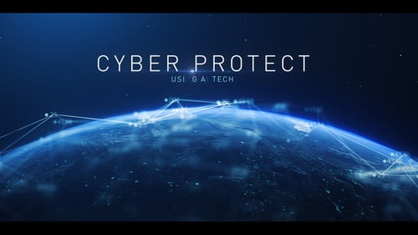

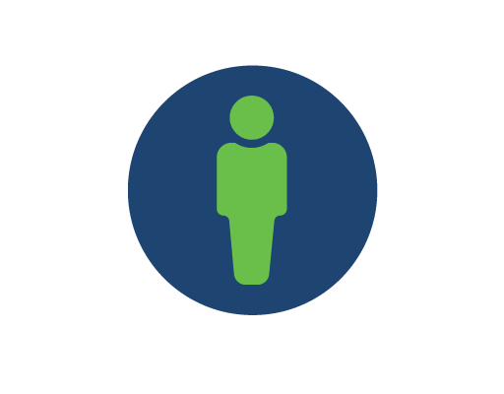
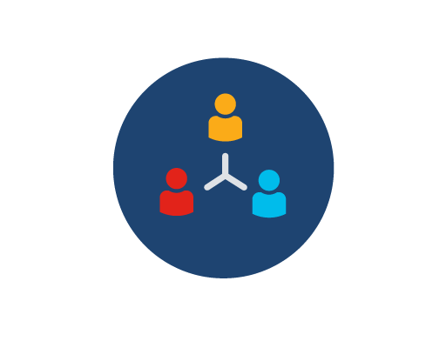
THE WORLD OF CYBER-SECURITY
What Is Cyber-security?
Cybersecurity is the ongoing effort to protect individuals, organizations and governments from digital attacks by protecting networked systems and data from unauthorized use or harm.
The three levels of protection
Personal
On a personal level, you need to safeguard your identity, your data, and your computing devices.
Organizational
At an organizational level, it is everyone’s responsibility to protect the organization’s reputation, data and customers.
Government
As more digital information is being gathered and shared, its protection becomes even more vital at the government level, where national security, economic stability and the safety and wellbeing of citizens are at stake.

Slide 3


PROTCTING YOUR PERSONAL DATA
Personal data is any information that can be used to identify you, and it can exist both offline and online.
Difference between your online and offline identity
Offline identity
Your offline identity is the real-life persona that you present on a daily basis at home, at school or at work. As a result, family and friends know details about your personal life, including your full name, age and address.
It’s important not to overlook the importance of securing your offline identity. Identity thieves can easily steal your data from right under your nose when you’re not looking!
Online identity
Your online identity is not just a name. It’s who you are and how you present yourself to others online. It includes the username or alias you use for your online accounts, as well as the social identity you establish and portray on online communities and websites.
You should take care to limit the amount of personal information you reveal through your online identity.
NB
Many people think that if they don’t have any social media or online accounts set up, then they don’t have an online identity. This is not the case. If you use the web, you have an online identity.

